Slide 1









IETE Student Forum
Amrita Vishwa Vidyapeetham
Team Name :Novus Thinkers
Team Leader Name : Nikitha Sree TY
Track : Generative AI

Slide 2


Brief about the Idea:
Safe Gen-Health is a Generative AI-based healthcare assistance system focused on improving patient understanding of medical reports.
Medical reports are usually written using technical terminology, which common people cannot easily understand.
This system converts complex medical values into simple, human-readable explanations.
The solution is strictly non-diagnostic and does not suggest treatment or medication.
The primary goal is to improve health literacy while maintaining ethical and safety boundaries.
The idea emphasizes responsible use of Generative AI rather than medical decision automation.

Slide 3
Opportunity & Problem Context
Millions of patients receive lab reports daily but lack clarity about their meaning.
Patients often panic or search random online sources, leading to misinformation.
Existing tools either:
  Only display numeric ranges, or
  Provide unsafe medical advice.
How This Is Different
Focuses only on explanation, not diagnosis.
Uses safety-bounded Generative AI instead of uncontrolled chatbots.
Designed for real-world deployment without legal or ethical risk.

Slide 4
Problem-Solving Approach
Converts medical terms into simple, calm language.
Explains:
  What a test indicates
  Why values may vary
Reduces fear and confusion without influencing medical decisions.
Encourages patients to consult doctors with better understanding

Slide 5
Unique Selling Proposition (USP)
Safety-bounded Generative AI architecture.
Explanation-only healthcare AI.
Ethical design with hard constraints.
Ready for real-world adoption in clinics and labs.
No regulatory or compliance risk.

Slide 6
Key Features
Plain-language explanation of medical parameters.
Normal vs abnormal interpretation without alarm.
Calm and reassuring explanation tone.
Mandatory medical disclaimer.
User-friendly web interface.
Future scope:
  Local language support
  PDF report upload

Slide 7
Process Flow
User enters medical report values.
System extracts key medical parameters.
Safety rules are applied to restrict output.
Disclaimer is added
Patient-friendly explanation is displayed.
Generative AI produces explanation.

Slide 8
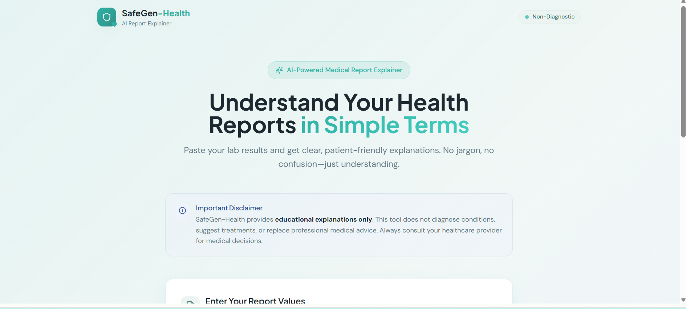
The Appearance of the Prototype :

Slide 9
Thank You!
Team Name
Track

